Slide 1

Cinema System
Group 6: Weijie Guan, Yining Wang

Slide 2
The problem We designed a ticketing database to meet these requirements
With the development of 3D and iMax technology, the experience of watching films in the cinema becomes increasingly better than that at home. People tend to go out for entertainment nowadays.
As the number of customers grows, traditional management may require more human resources and financial resources. A management method with higher efficiency and confidentiality will help the cinema to better improve its operation.

Slide 3
Requirements The ticketing database for a cinema should meet the following requirements:
It has the basic functions including playing the films, selling tickets, checking tickets, dealing with useless data.
It can be applied to the snack corner, either.
It can deal with the expired tickets.
A customer can choose whether to buy a ticket for one time, or to join the vip club which has more discounts.

Slide 4
VIP discount
We suppose that if a customer want to join the VIP club, he must prepay for a VIP card. Each consumption in the cinema using the VIP card will add a credit of 10% of the bill to his account. He can use the credit to buy goods in the snack corner or buy film tickets.

Slide 5
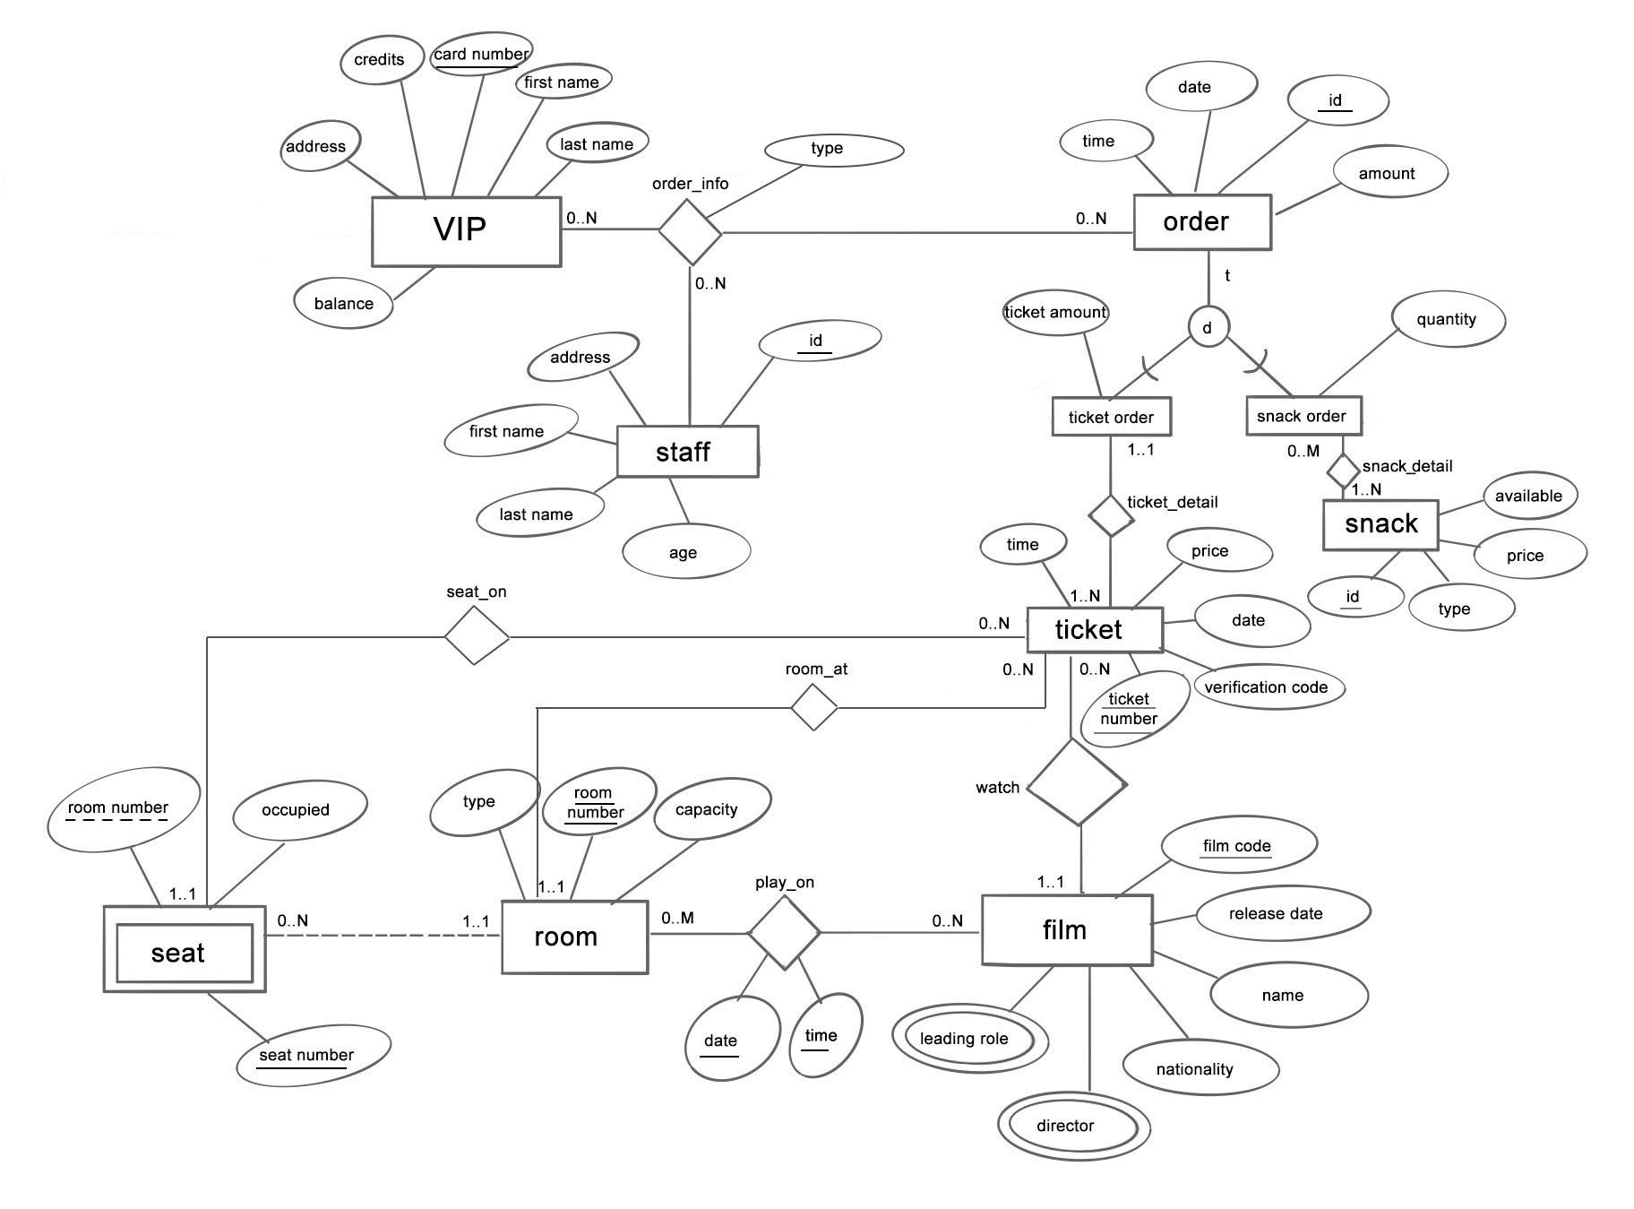
EER Model
Authority of a staff:
Adding, searching, editing and deleting a VIP member’s information in the system.
Adding or deducting credits and balance in a customer’s VIP account.
Looking up the information of a film to be played and finding out its room number.
Looking up the tickets left and the tickets sold together with the seats they match.
Selling tickets.
Adding, deleting and editing the information of goods.
Selling goods.
Checking the verification code for a ticket.
Checking the date and time for a ticket.

Slide 6
EER Model
Information for a VIP member includes: card number, first name, last name, phone number, address, balance in the card, credits in the card
Information for a film includes: film code, name of the film, director, leading role, nationality, release date(year)
Information for a seat: seat number, whether it is occupied, room number
Information for a room: room number, type, capacity
Information for a snack: snack id, type, price, availability

Slide 7
EER Model
Information for a ticket: ticket number, verification code, film code, price, date, time, seat number, room number, order id
Information for the staff: age, id, address, first name, last name
Each bill is recorded as an order, the information for an order includes: time, date, id, amount
Orders can be divided into snack order and ticket order
The contents of order information are: VIP id, id of the staff who record the order, order id and order type(ticket or snack)

Slide 8
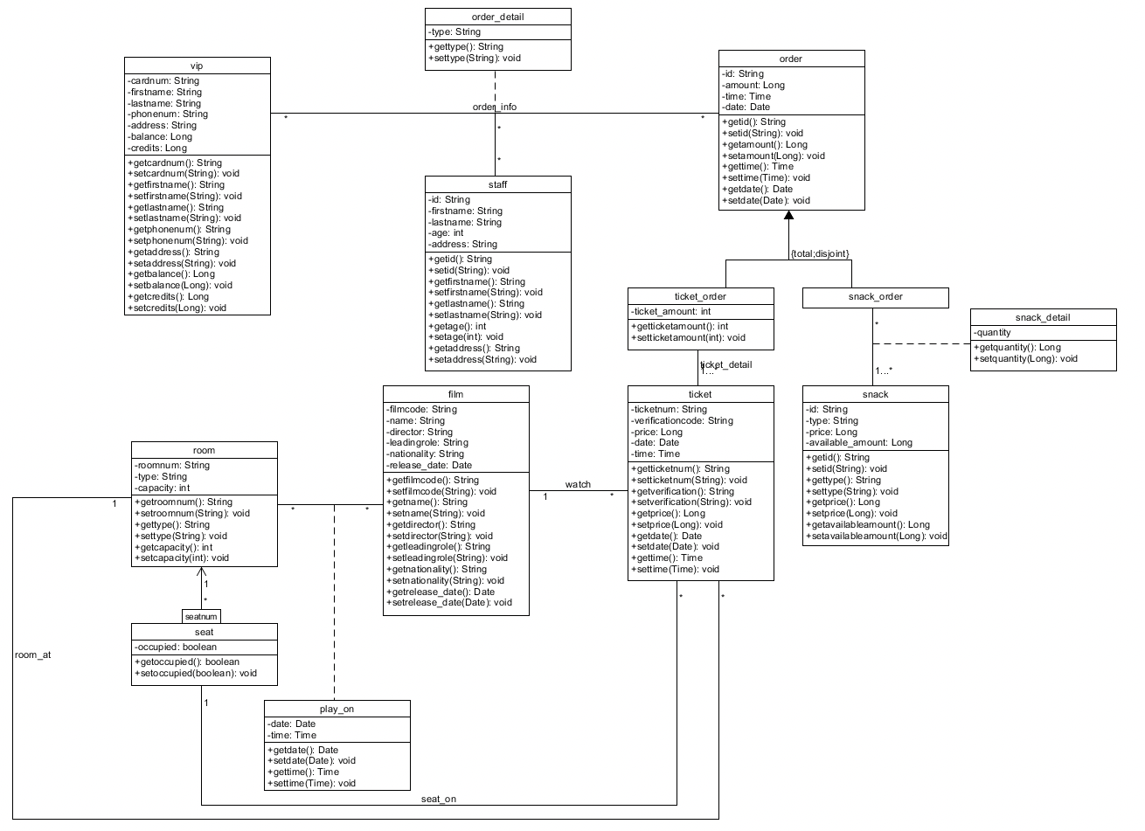
UML class diagram

